Slide 1
Operating Systems
Chapter 11 I/O Management and Disk Scheduling

Slide 2
Agenda
11.1 I/O Devices
11.2 Organization of the I/O Function
11.3 Operating System Design Issues
11.4 I/O Buffering
11.5 Disk Scheduling
11.6 RAID
11.7 Disk Cache
11.8 Summary

Slide 3
Categories of I/O Devices(I/O设备分类)
Roughly grouped into three categories:
1. Human readable(人可读)
  Used to communicate with the user
  Printers
  Video display terminals
  Input terminals
    Keyboard
    Mouse

Slide 4
Categories of I/O Devices
2. Machine readable(机器可读)
  Used to communicate with electronic equipment
  Disk and tape drives
  Sensors
  Controllers

Slide 5
Categories of I/O Devices
3. Communication(通信)
  Used to communicate with remote devices
  Digital line drivers
  Modems
  Network device

Slide 6
Differences in I/O Devices
1. Data rate
  May be differences of several orders of magnitude(数量级) between the data transfer rates

Slide 7
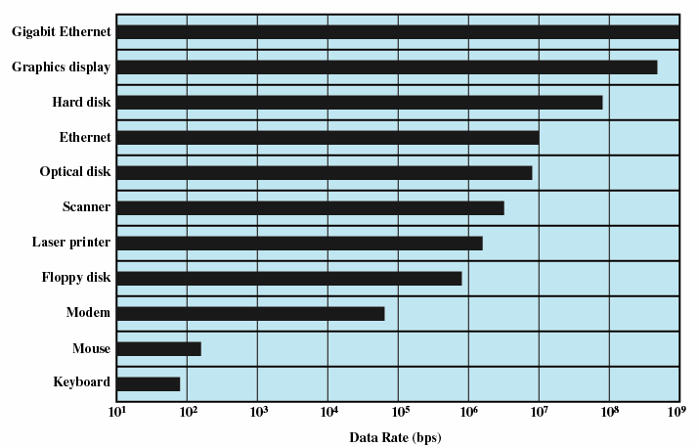
Typical I/O Device Data Rates

Slide 8
Differences in I/O Devices
2. Application
  Disk used to store files requires file management software
  Disk used to store virtual memory pages needs special hardware and software to support it
  Terminal used by system administrator may have a higher priority
Notes:
Io的应用方面，不同应用，不同要求
不同的终端用户，这两种使用情况隐含了不同的特权级别，而且可能在操作系统中拥有不同的优先权。

Slide 9
Differences in I/O Devices
3. Complexity of control
4. Unit of transfer（传送单位）
  Data may be transferred as
    a stream of bytes，e.g. terminal
    in larger blocks, e.g. disk
5. Data representation
  Encoding schemes
6. Error conditions
  Devices respond to errors differently
Notes:
控制复杂性，打印机简单，硬盘复杂

Slide 10
Agenda
11.1 I/O Devices
11.2 Organization of the I/O Function
11.3 Operating System Design Issues
11.4 I/O Buffering
11.5 Disk Scheduling
11.6 RAID
11.7 Disk Cache
11.8 Summary
Notes:
周三班

Slide 11
Performing I/O
1. Programmed I/O(可编程I/O)
  Process is busy-waiting for the operation to complete
2. Interrupt-driven I/O(中断驱动I/O)
  I/O command is issued
  Processor continues executing instructions
  I/O module sends an interrupt when done
3. Direct Memory Access (DMA,直接存储器访问)
  DMA module controls exchange of data between main memory and the I/O device
  Processor interrupted only after entire block has been transferred

Slide 12
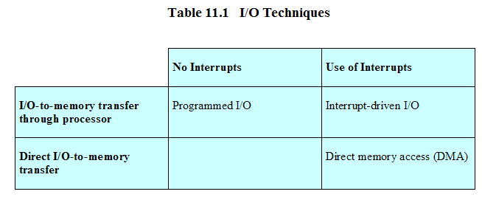
Relationship Among Techniques

Slide 13
Evolution of the I/O Function (I/O功能的发展)
Processor directly controls a peripheral device
  Processor has to handle details of external devices
Controller or I/O module is added
  Processor uses programmed I/O without interrupts
  Processor does not need to handle details of external devices

Slide 14
Evolution of the I/O Function
Controller or I/O module with interrupts
  Processor does not spend time waiting for an I/O operation to be performed
Direct Memory Access
  Blocks of data are moved into memory without involving（牵涉） the processor
  Processor involved at beginning and end only

Slide 15
Evolution of the I/O Function
I/O module (I/O channel) is enhanced to a separate processor
  The central processing unit (CPU) directs the I/O processor to execute an I/O program in main memory.
  The I/O processor fetches and executes these instructions without processor intervention.
I/O processor
  I/O module has its own local memory
  Its a computer in its own right

Slide 16
Direct Memory Access(直接存储器访问)
Processor delegates(委派) I/O operation to the DMA module
DMA module transfers data directly to or form memory
When complete DMA module sends an interrupt signal to the processor

Slide 17
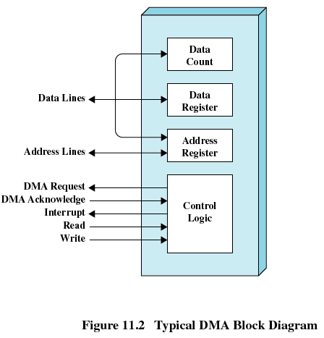
DMA Block diagram
Notes:
典型的DMA框图

Slide 18
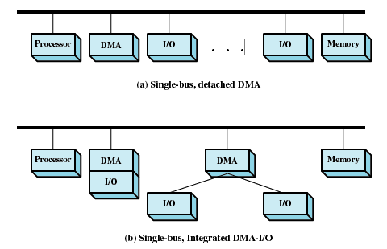
DMA Configurations
Notes:
分离的DMA，集成的DMA；单总线下

Slide 19
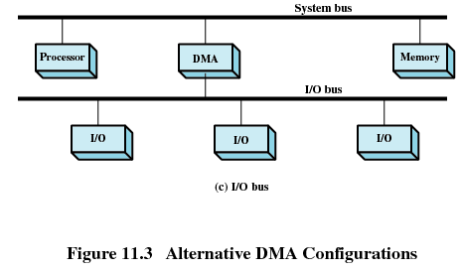
DMA Configurations
Notes:
可选择的DMA

Slide 20
Agenda
11.1 I/O Devices
11.2 Organization of the I/O Function
11.3 Operating System Design Issues
11.4 I/O Buffering
11.5 Disk Scheduling
11.6 RAID
11.7 Disk Cache
11.8 Summary

Slide 21
Operating System Design Issues(操作系统设计问题)
Efficiency and generality are most important objectives in designing the I/O facility
Efficiency (效率)
  Most I/O devices extremely slow compared to main memory，I/O cannot keep up with processor speed
  Use of multiprogramming(多道程序) allows for some processes to be waiting on I/O while another process executes
  Swapping(交换) is used to bring in additional Ready processes which is an I/O operation
Notes:
在设计io机制时，有两个最重要的目标: 效率 和 通用性
交换技术用于将额外的就绪,进程加载到内存，从而保持处理器处于工作状态，但这本身就是一个IO操作，

Slide 22
Operating System Design Issues
Generality (通用性)
  Desirable to handle all I/O devices in a uniform manner(统一模式)
  Hide most of the details of device I/O in lower-level routines so that processes and upper levels see devices in general terms such as read, write, open, close, lock, unlock

Slide 23
Agenda
11.1 I/O Devices
11.2 Organization of the I/O Function
11.3 Operating System Design Issues
11.4 I/O Buffering
11.5 Disk Scheduling
11.6 RAID
11.7 Disk Cache
11.8 Summary

Slide 24
I/O Buffering (I/O缓冲)
Reasons for buffering(缓冲原因)
  Processes must wait for I/O to complete before proceeding
  Certain pages must remain in main memory during I/O
Define of I/O buffering
  Performs input transfers in advance of requests being made and performs output transfers some time after the request is made(预输入，缓输出)

Slide 25
I/O Buffering
Block-oriented(面向块)
  Information is stored in fixed sized blocks
  Transfers are made a block at a time
  Used for disks and tapes
Stream-oriented(面向流)
  Transfers information as a stream of bytes
  Used for terminals, printers, communication ports, mouse and other pointing devices, and most other devices that are not secondary storage

Slide 26
Single Buffer(单缓冲)
Operating system assigns one buffer in the system space for an I/O request
Block-oriented single buffering
  Input transfers are made to buffer
  Block is moved to user space when needed
  Another block is requested immediately
    Read ahead(预读), or anticipated input(预输入)

Slide 27
Single Buffer
Advantages of block-oriented single buffer
  User process can process one block of data while next block is read in
  Swapping can occur since input is taking place in system memory, not user memory
Disadvantages of block-oriented single buffer
  Operating system keeps track of assignment of system buffers to user processes
  The swapping logic is affected

Slide 28
Single Buffer
Stream-oriented single buffer
  Line-at-a-time fashion
    Input from or output to a terminal is one line at a time with carriage return signaling the end of the line
  Bye-at-a-time fashion
    Input and Output follow the producer/consumer model
Notes:
回车换行符

Slide 29
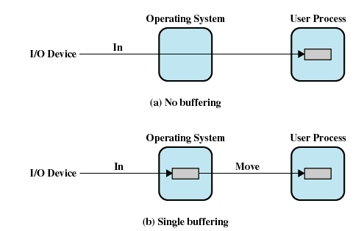
I/O Buffering
处理时间：T+C
T：传输时间
C：计算时间
M：移动时间
处理时间：max[T, C]+M

Slide 30
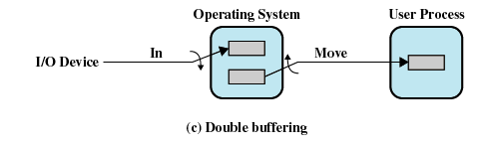
Double Buffer(双缓冲)
Use two system buffers instead of one
A process can transfer data to or from one buffer while the operating system empties or fills the other buffer
处理时间：max[T, C]

Slide 31
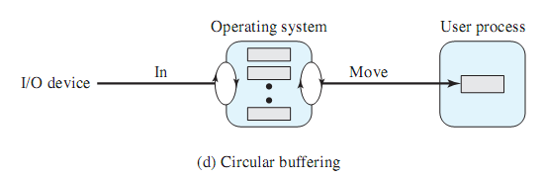
Circular Buffer(循环缓冲)
More than two buffers are used
Each individual buffer is one unit in a circular buffer
Used when I/O operation must keep up with process

Slide 32
Agenda
11.1 I/O Devices
11.2 Organization of the I/O Function
11.3 Operating System Design Issues
11.4 I/O Buffering
11.5 Disk Scheduling
11.6 RAID
11.7 Disk Cache
11.8 Summary

Slide 33
Disk Performance Parameters
To read or write, the disk head must be positioned at the desired track(磁道) and at the beginning of the desired sector(扇区)

Slide 34
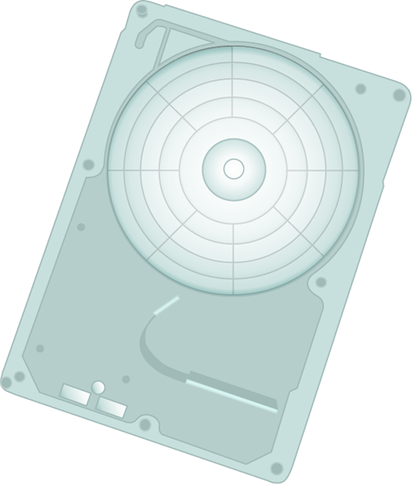


Seek time (寻道时间)
Time it takes to position the head(磁头) at the desired track
Notes:
Seek times describes the time it takes to position the read/write heads radially across the platter. The following specifications are often published:
Full Stroke - the time it takes to move across the entire width of the disk, from the innermost track to the outermost.
Average – the average time it takes to move from one random track to another (normally listed as the time for one-third of a full stroke).
Track-to-Track – the time it takes to move between adjacent tracks.
Each of these specifications is measured in milliseconds (ms).

Slide 35
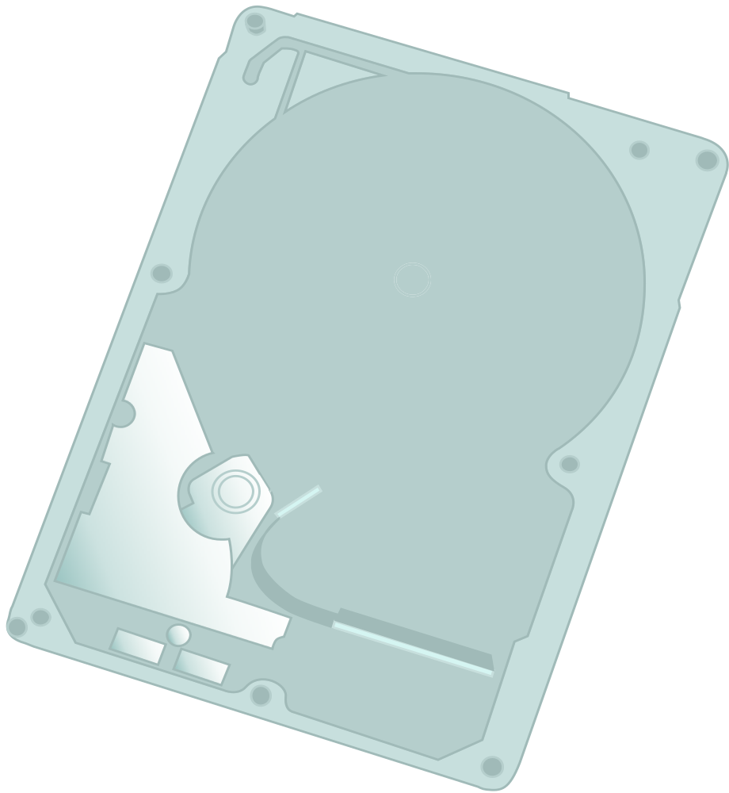
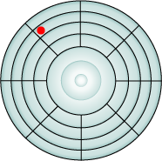

Rotational delay (旋转延迟)
Time its takes for the beginning of the sector to reach the head
Notes:
The actuator moves the read/write head over the platter to a particular track, while the platter spins to position the a particular sector under the read write head.
Rotational latency is the time that it takes the platter to rotate and position the data under the read/write head.
Rotational latency is dependent upon the rotation speed of the spindle and is measured in milliseconds (ms)
The average rotational latency is one-half of the time taken for a full rotation.
Like seek times, rotational latency has more of an impact on reads or writes of random sectors on the disk than on the same operations on adjacent sectors.
Instructor note: rotational latency is around 5.5 ms for a 5,400 rpm drive, and around 2.0 ms for a 15,000 rpm drive.
转每秒

Slide 36
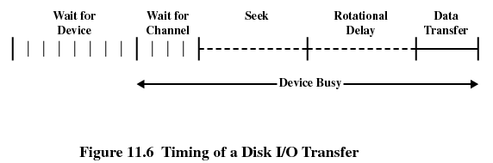
Timing of a Disk I/O Transfer

Slide 37

Disk Performance Parameters(磁盘性能参数)
Access time(存取时间)
  The time it takes to get in position to read or write
  Sum of seek time (T_{s}) and rotational delay (1/2r)
Transfer time(传输时间, b/(rN) )
  Data transfer occurs as the sector moves under the head
Thus the total average access time can be expressed as:
Ta：总平均存取时间
Ts：平均寻道时间
r：旋转速度，转/秒
b：要传送字节数
N：一个磁道的字节数

Slide 38
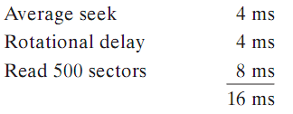
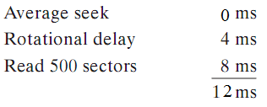
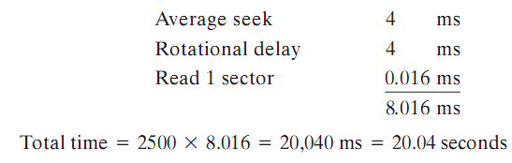
A Timing Comparison
Sequential access: 5 adjacent tracks, 500 sectors/track, total 2500 sectors，r(转速)7500r/m
First track: Next 4 tracks:
Random access: 2500 sectors
Notes:
7500转每分，转一圈需要8毫秒。1.28M

Slide 39
Disk Scheduling Policies
(磁盘调度策略)
Seek time and rotational delay are the reasons for differences in performance
  The key to increase performance of disk is to minimize seek time
Random scheduling
  For a single disk there will be a number of I/O requests
  If requests are selected randomly(random scheduling, 随机调度), we will poor performance
  used to evaluate other techniques
Notes:
evaluate 评估

Slide 40
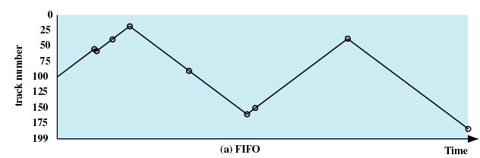
Disk Scheduling Policies
First-in, first-out (FIFO)
  Process request sequentially
  Fair to all processes
  Approaches random scheduling in performance if there are many processes
55、58、39、18、90、160、150、38、184

Slide 41
Disk Scheduling Policies
Priority(优先级)
  Goal is not to optimize disk use but to meet other objectives
  Short batch jobs may have higher priority
  Provide good interactive response time
Notes:
优先级调度，没有优化磁盘访问，主要解决短作业优先，好的响应时间，长作业不理

Slide 42
Disk Scheduling Policies
Last-in, first-out (LIFO)
  Good for transaction processing systems
    The device is given to the most recent user so there should be little arm movement
  Possibility of starvation since a job may never regain the head of the line
Notes:
后来者优先，可以访问连续，摆臂幅度最小；但是前面来的用户请求恐怕会迟迟不响应

Slide 43
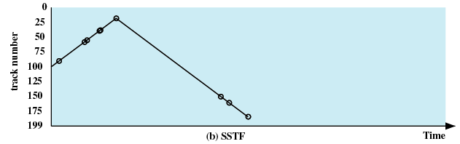
Disk Scheduling Policies
Shortest Service Time First (SSTF)
  Select the disk I/O request that requires the least movement of the disk arm from its current position
  Always choose the minimum Seek time
55、58、39、18、90、160、150、38、184

Slide 44
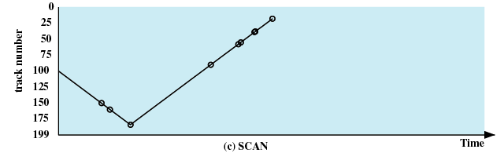
Disk Scheduling Policies
SCAN
  Arm moves in one direction only, satisfying all outstanding requests until it reaches the last track in that direction
  Direction is reversed
55、58、39、18、90、160、150、38、184

Slide 45
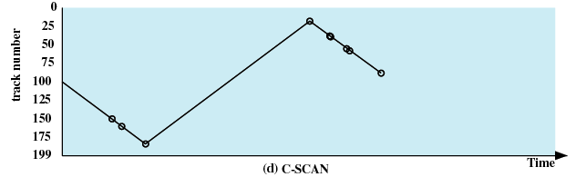
Disk Scheduling Policies
C-SCAN (circular SCAN)
  Restricts scanning to one direction only
  When the last track has been visited in one direction, the arm is returned to the opposite end of the disk and the scan begins again
55、58、39、18、90、160、150、38、184

Slide 46
Disk Scheduling Policies
N-step-SCAN
  Segments the disk request queue into subqueues of length N
  Subqueues are processed one at a time, using SCAN
  New requests added to other queue when queue is processed
FSCAN
  Two queues
  One queue is empty for new requests

Slide 47
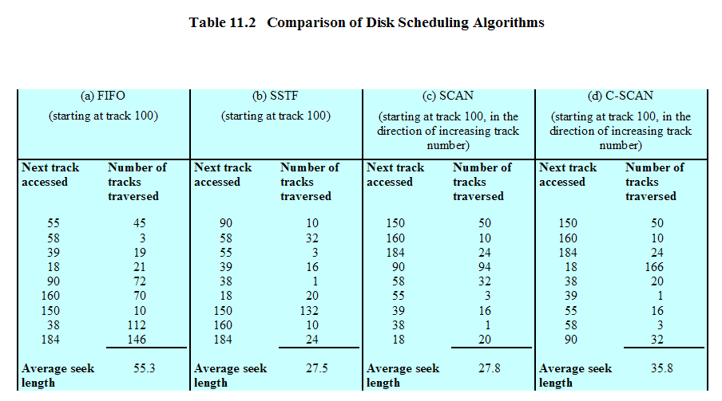
Disk Scheduling Algorithms

Slide 48
Agenda
11.1 I/O Devices
11.2 Organization of the I/O Function
11.3 Operating System Design Issues
11.4 I/O Buffering
11.5 Disk Scheduling
11.6 RAID
11.7 Disk Cache
11.8 Summary

Slide 49
RAID
Redundant Array of Independent Disks (独立冗余磁盘阵列) or Redundant Array of Inexpensive (廉价冗余磁盘整列)
Set of physical disk drives viewed by the operating system as a single logical drive
Data are distributed across the physical drives of an array
Redundant disk capacity is used to store parity information

Slide 50
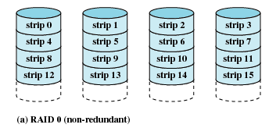
RAID 0 (non-redundant)

Slide 51
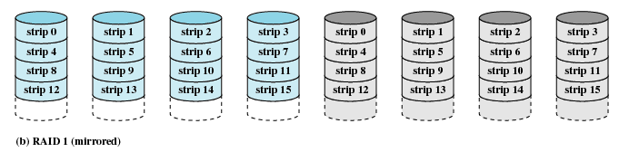
RAID 1 (mirrored)

Slide 52
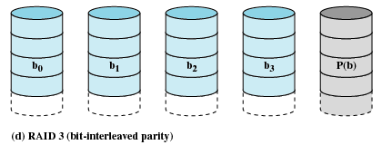
RAID 3 (bit-interleaved parity)
RAID3(交错位奇偶数校验)

Slide 53
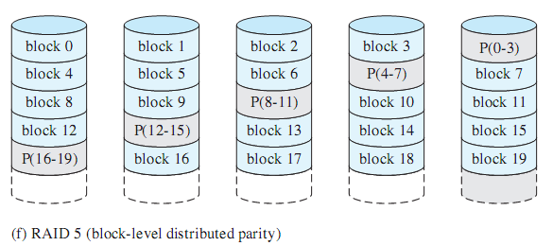
RAID 5 (block-level distributed parity)
交错块分布奇偶校验

Slide 54
Agenda
11.1 I/O Devices
11.2 Organization of the I/O Function
11.3 Operating System Design Issues
11.4 I/O Buffering
11.5 Disk Scheduling
11.6 RAID
11.7 Disk Cache
11.8 Summary

Slide 55
Disk Cache
Buffer in main memory for disk sectors
Contains a copy of some of the sectors on the disk
Two design issues:
  Method to transfer the block of data from the disk cache to memory assigned to the user process(缓存数据 与 用户空间 交换)
    Data move
    Pointer passing
  The replacement strategy(置换策略) when the disk cache is full for store new data

Slide 56
Replacement Strategy 1: Least Recently Used (最近最少使用)
The block that has been in the cache the longest with no reference to it is replaced
The cache consists of a stack of blocks
Most recently referenced block is on the top of the stack
When a block is referenced or brought into the cache, it is placed on the top of the stack

Slide 57
Replacement Strategy 1: Least Recently Used
The block on the bottom of the stack is removed when a new block is brought in
Blocks don’t actually move around in main memory，A stack of pointers is used
Notes:
并不需要在内存中真正移动这些块，有一个栈指针（移动指针）

Slide 58
Replacement Strategy 2: Least Frequently Used (最不常用)
The block that has experienced the fewest references is replaced
A counter is associated with each block
Counter is incremented each time block accessed
Block with smallest count is selected for replacement
Some blocks may be referenced many times in a short period of time and the reference count is misleading
Notes:
由于局部性原理，会在一段很短的时间间隔里出现很多重复访问，从而使
访问计数器的值很高。当这个间隔过去后，访间计数器的值可能会让人误解，它并不表示很快又会访问到这一块。因此受局部性影响，LFU算法不是一个好的置换算法。

Slide 59
Agenda
11.1 I/O Devices
11.2 Organization of the I/O Function
11.3 Operating System Design Issues
11.4 I/O Buffering
11.5 Disk Scheduling
11.6 RAID
11.7 Disk Cache
11.8 Summary

